Slide 1
Identifying immune cell subsets associated with irAE development
12-19-2024
Ty Bottorff – Bioinformatics postdoc
Linsley lab

Slide 2

Acknowledgements
Holly Akilesh
Long lab/HIPcore
Alice Long, Alice Wiedeman
Bernard Khor
Buckner lab
Jane Buckner, Sylvia Posso
Peter Linsley
Bioinformatics
Hannah DeBerg
Basilin Benson
Andrew Koval
Clinical team

Slide 3
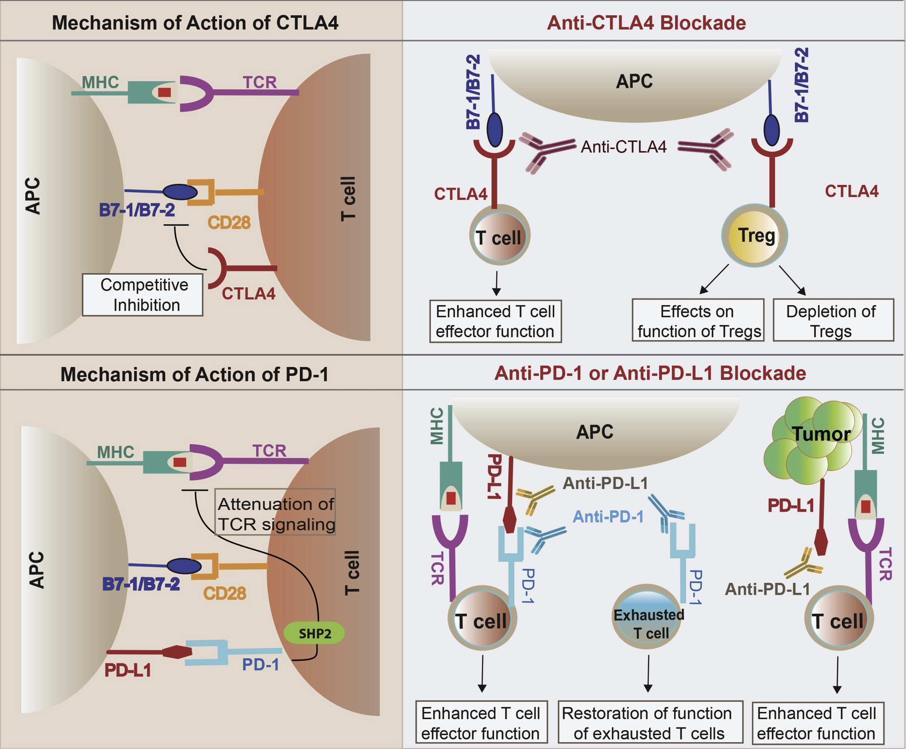
Immune checkpoint inhibitors (ICIs) have revolutionized cancer treatment
Khan et al. Semin Cancer Biol. 2020
Notes:
Script
Immune checkpoint pathways are often activated in cancer, helping tumors evade the immune response
Immune checkpoint blockade acts to block inhibitory checkpoint molecules to enhance immune activity against tumors
Over the last decade, ICB have revolutionized cancer treatment.
CTLA-4 and PD-1/PD-L1 constitute the majority of currently FDA approved ICB drugs.
For example, PD-L1 (PD-1 ligand) expressed on tumor cells, binds PD-1 on T cells to inhibit their activation
Other notes
CTLA-4 expressed on tumor infiltrating Tregs, also activated CD4 T cells, exhausted T cells
CTLA-4 blockade likely acts in draining lymph node where CTLA-4 expressing Tregs
In 2011, ipilimumab (Yervoy) became the first ICI to receive FDA approval for metastatic melanoma. As of 2023, it remains the only CTLA-4 targeting ICI that received FDA approval
Mechanisms of immune-related adverse events during the treatment of cancer with immune checkpoint inhibitors
anti-CTLA-4 and anti-PD-1/PD-L1 antibodies called "immune enhancers" and "immune normalizers" (normalizing T cell immunity in tumor microenvironment), respectively, consistent with PD-1 blockade having less irAEs

Slide 4
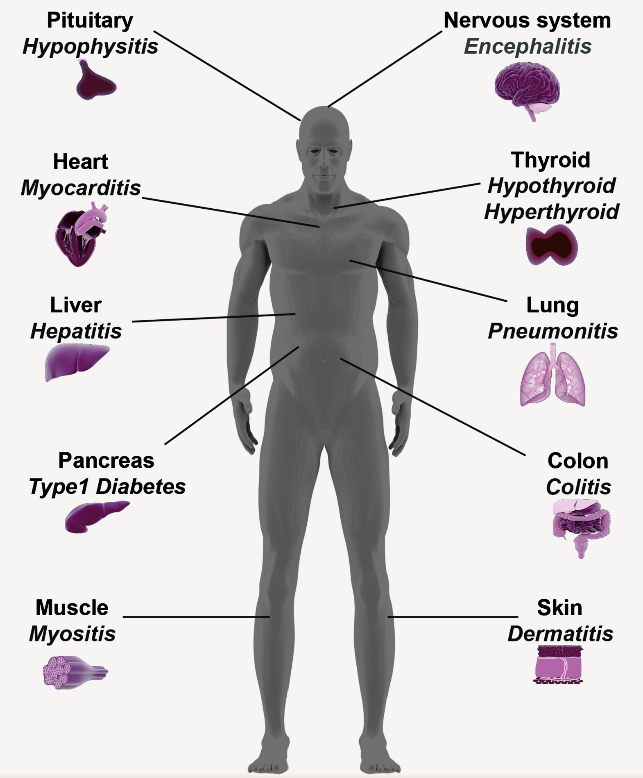
ICIs can lead to the development of immune-related adverse events (irAEs)
Khan et al. Semin Cancer Biol. 2020
Notes:
irAEs are autoimmune-like inflammatory pathologies

Slide 5
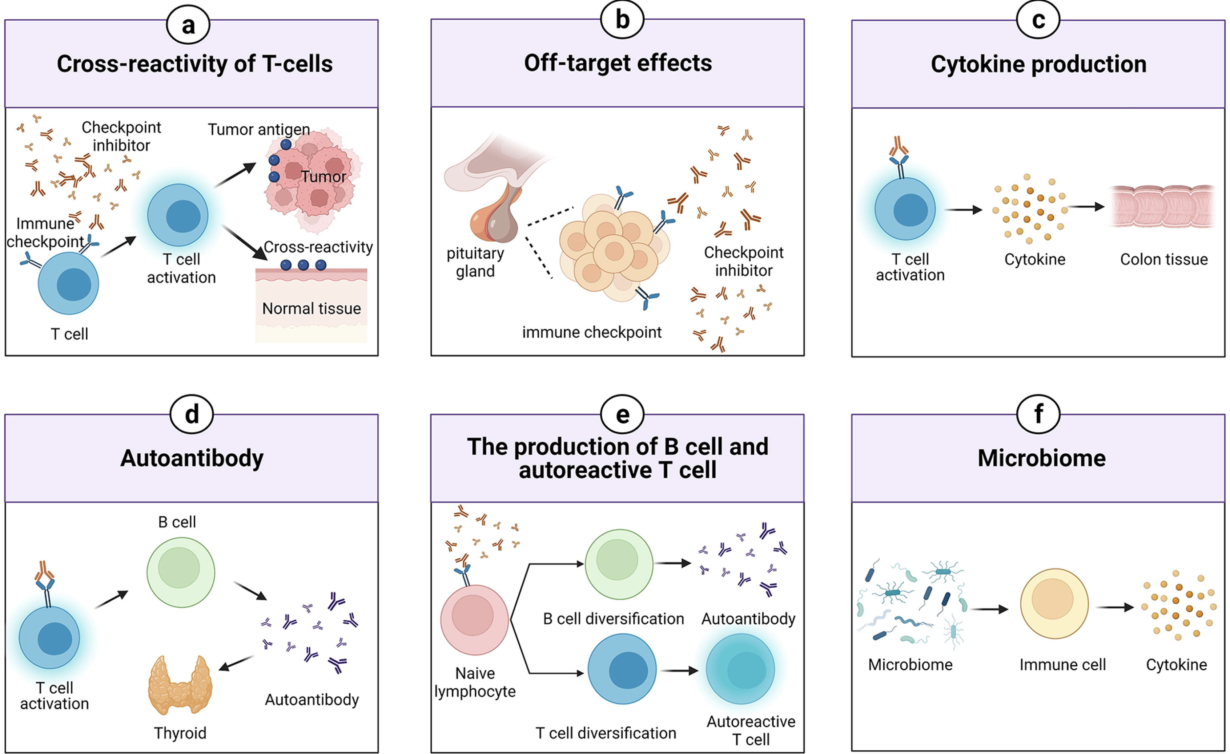
Possible mechanisms driving irAEs
Zheng et al. Materials & Design. 2022
Notes:
TCRs estimated to potentially react with 1 in ~10k encountered peptides (PMID37409132)
Killed tumor cells may release antigens shared by normal cells (i.e. non-tumorigenic proteins still in tumor cell), healthy cells around tumor may also be killed in crossfire and release antigens that induce response
Speculation for what crossreactive T cells are actually targeting, perhaps T cells targeting cancer neoantigens cross-react with WT version of protein in healthy tissue (Autoreactive napsin A-specific T cells are enriched in lung tumors and inflammatory lung lesions during immune checkpoint blockade)
Gouttefangeas et al. Front Immunol. 2023
TCR conceivably could recognize ~ 1 million peptides, crossreactive peptides likely often better agonists than original one that activated T cell, but few (~1%) of peptides are actually presented on MHC, so probably crossreactivity estimate closer to 1 in ~10,000
estimate TCRs to be able to bind ~10^5 to 10^6 peptides (Amino acid similarity accounts for T cell crossreactivity and for "holes" in the T cell repertoire)
What makes TCRs crossreactive? cross-reactivity need not result from sequence similarity (3D structural similarity more important than 1D sequence similarity (Peter’s paper: Autoreactive T cell receptors with shared germline-like α chains in type 1 diabetes)
(b) ICIs can target normal tissues such as hypothalamic and pituitary tissues directly which express immune checkpoint ligand
Pituitary expression of CTLA-4 mediates hypophysitis secondary to administration of CTLA-4 blocking antibody
(c) Activated T cells can release inflammatory mediators which lead to damage in normal tissues
(d) The production of autoantibodies is associated with the risk of irAEs. autoantibodies present ~50% of time for irAEs
(e) ICIs can induce the diversification of lymphocytes as well as promoting T/B cell activation and proliferation
(f) The microbiome with certain bacterial species can shift immune lineage to pro-inflammatory or anti-inflammatory subtypes respectively thereby inducing or resisting irAEs
# Advances in research on molecular markers in immune checkpoint inhibitor-associated myocarditis
- irAE hypotheses: ICIs bind to cell surface proteins (like CTLA-4) in normal tissue leading to T cell infiltration (**this is an obvious one I don't think about much**), crossreactive T cells (T cells recognizing tumor antigens enter circulation and identify similar antigens in healthy tissue), via cytokines (promote infiltration of inflammatory molecules into nontarget tissue, ICIs increase circulating cytokine levels, **this is a good one I don't think about much**), autoantibodies
# B cells as biomarkers: predicting immune checkpoint therapy adverse events
- association between early therapy-induced changes in circulating B cells (decreased B cells, increased plasmablasts and CD21<sup>low</sup>PD-1<sup>+</sup> memory B cells) and an increased risk of high-grade irAEs in patients treated with ICB

Slide 6
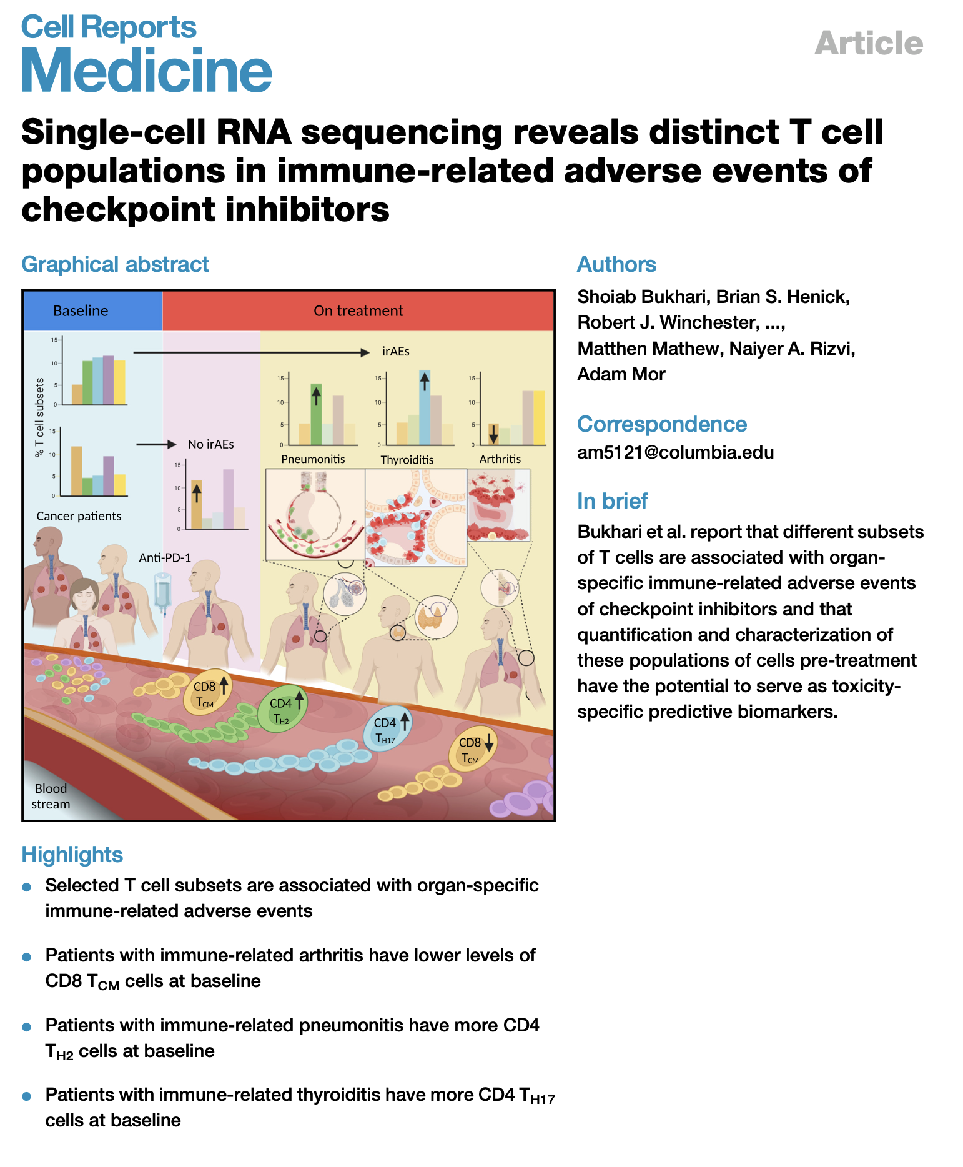
Baseline abundances of different cell types have been associated with different organ irAEs
Notes:
lower baseline levels of CD8 TCM cells in arthritis irAE patients, higher CD4 Th2 baseline levels in pneumonitis irAE patients, higher CD4 Th17 baseline levels in thyroiditis irAE patients (PMID: 36513074)

Slide 7
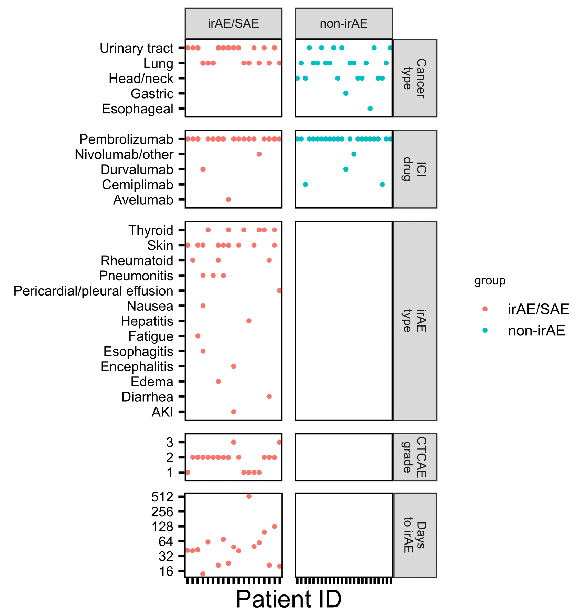
Cancer cohort
multiple primary cancer types
almost exclusively treated with anti PD-1
skin, thyroid irAEs well-represented
Notes:
Longitudinal data, draw schedule: visits 2/3 after 1st/2nd infusion (ICI), then some more after irAE development in irAE group

Slide 8
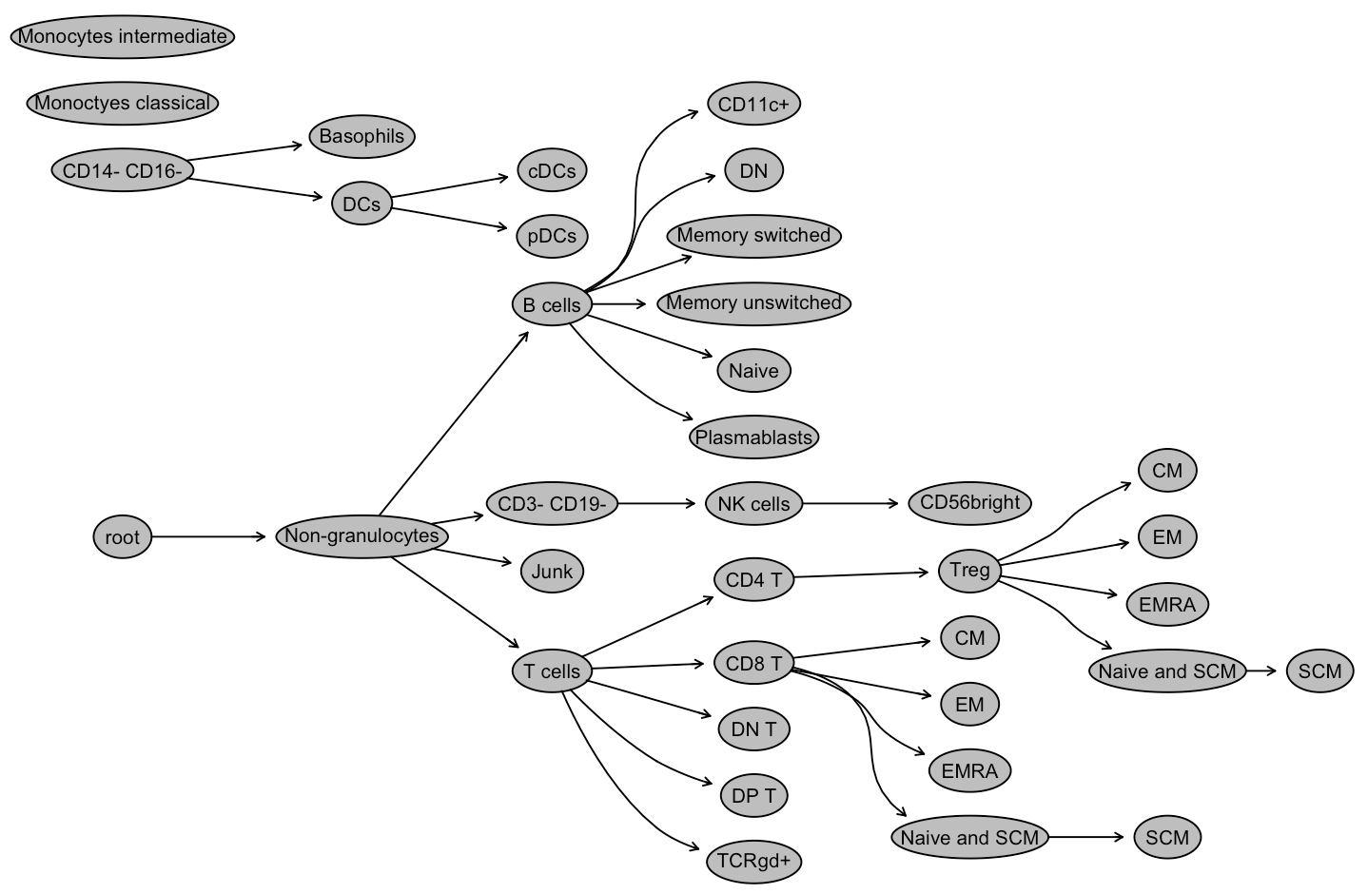
80 reportables to gauge cell subsets
Broad subsets (T, B, NK, monocytes…)
Memory subsets of T/B cells
Special CD4/CD8 subsets
PD1⁺ T/B/NK, PDL1⁺ (monocytes)
Notes:
80 reportables* (FlowJo, Alice Wiedeman)
Broad subsets (PMN, T, B, NK, Mono, DC)
Memory subsets of T (Tconv, Treg, CD8) and B
Special subsets of CD4 and CD8 T
PD1 on T/B/NK; PDL1 on Mono

Slide 9
Main questions
Do baseline immune features predict irAE development?
Is irAE development associated with specific changes in immune features on ICI?
Notes:
hypothesis that ICI-induced irAEs, similar to flare-ups in patients with primary autoimmunity, are symptomatic exacerbations that occur in the context of a baseline dysregulated immune state unleashed by ICI treatment.

Slide 10
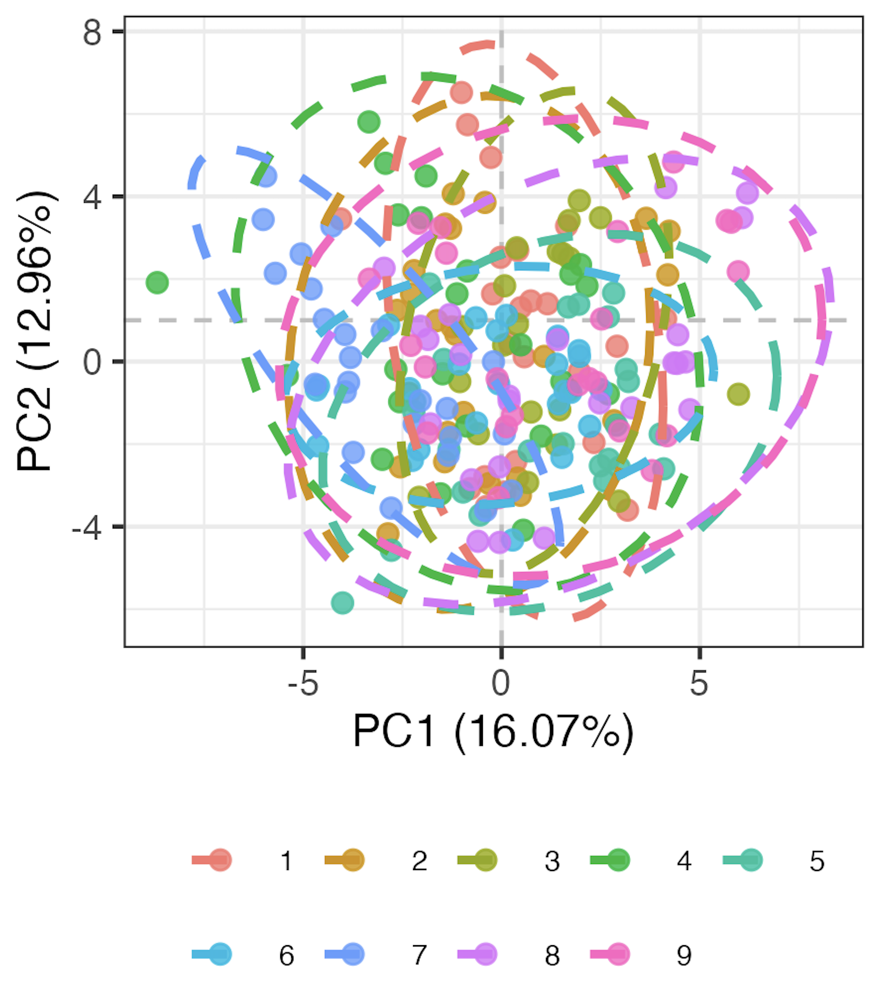
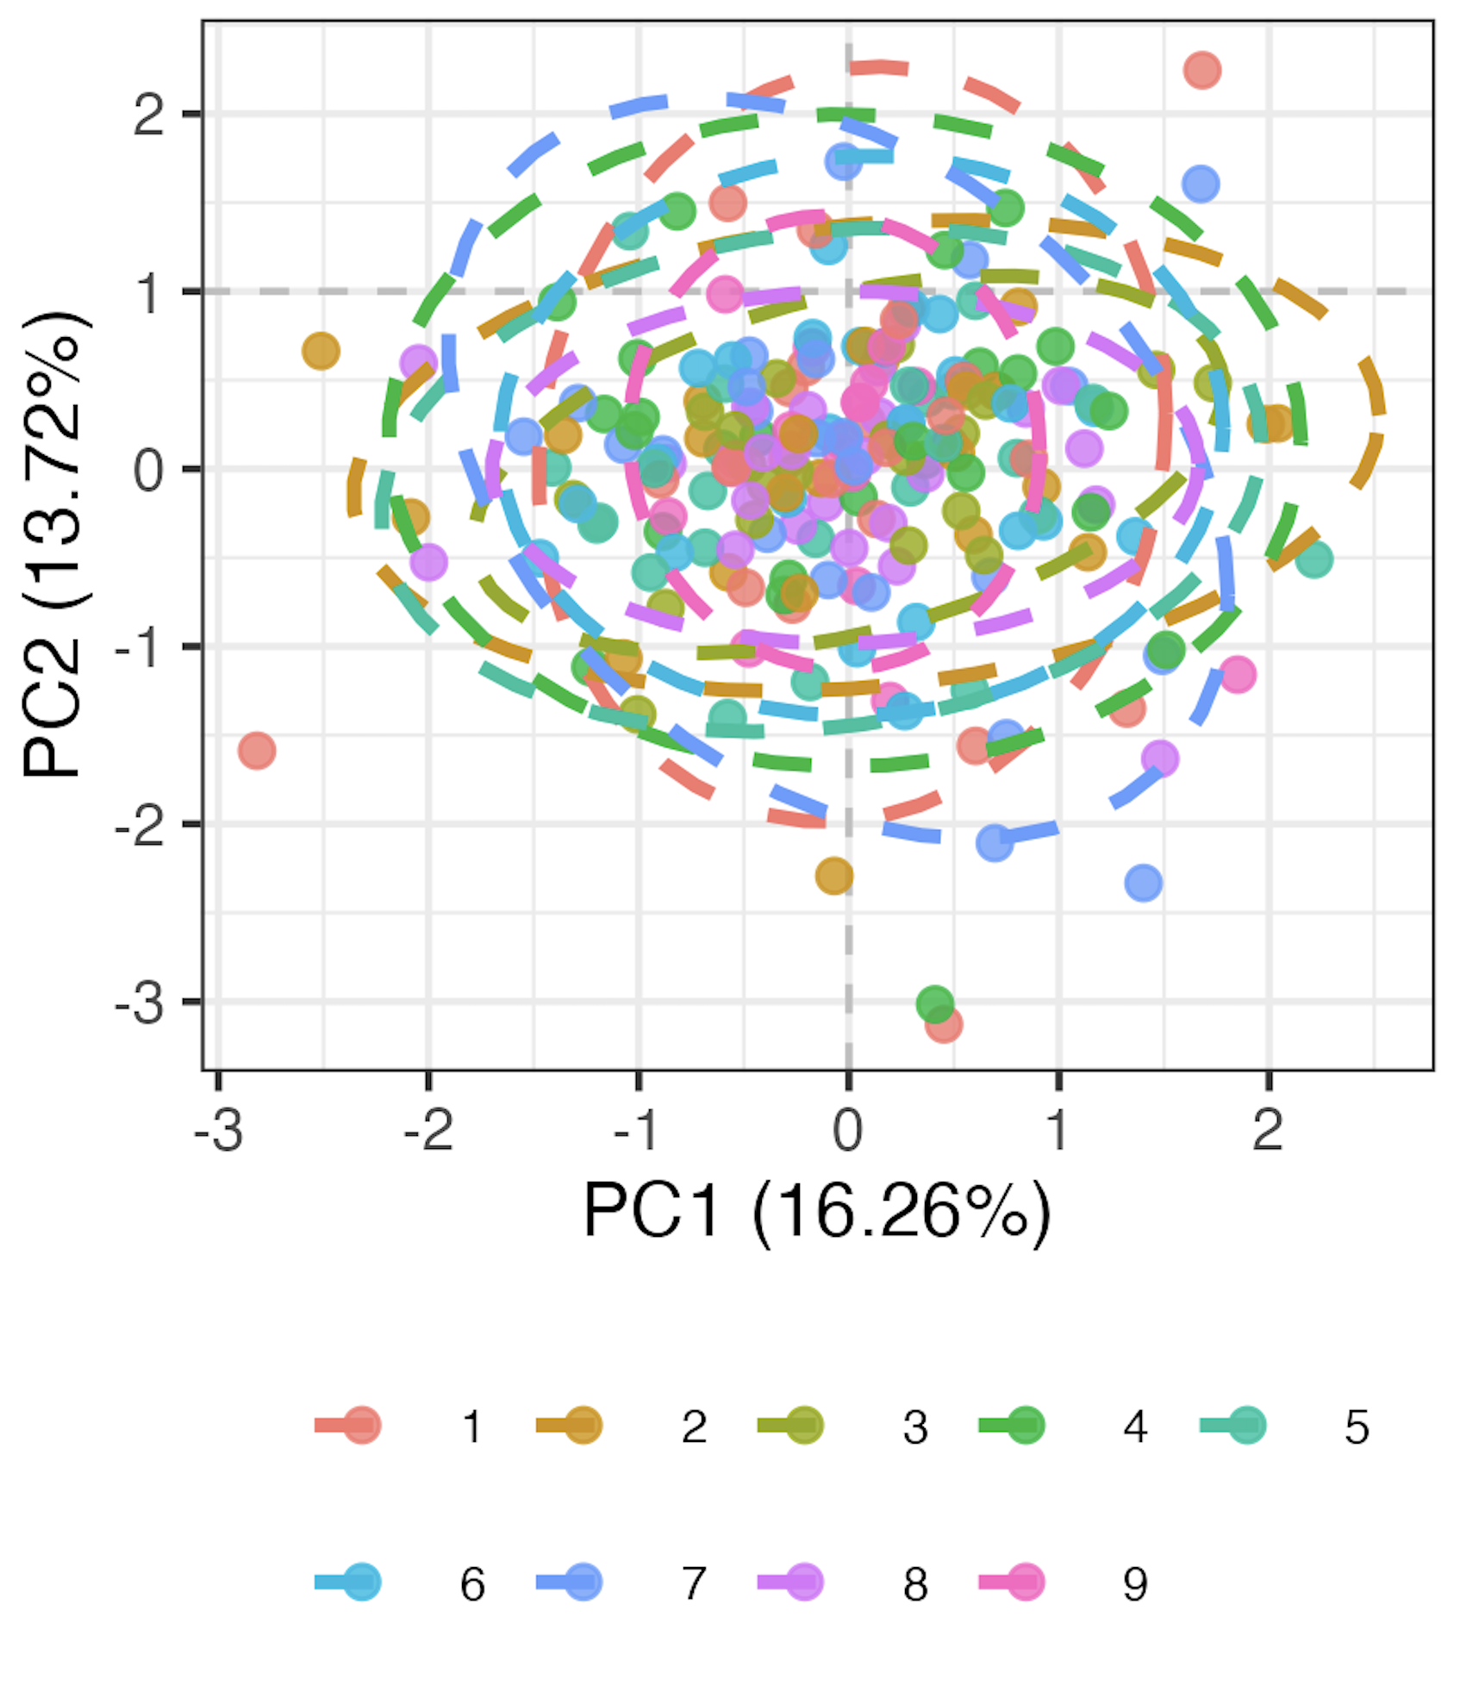
Preparing data
Remove 9 features with high technical variation
Normalize percent of parent data
Logit transform, Z-scale
Run mixed-effects LM for each of 71 remaining features, take residuals as batch-corrected data
Pre
Post
model <- lmer(freq ~ batch + (1|patient_id))
Batch
Batch
Notes:
Logit transforms 0-1 to –inf, inf to normalize data
This is likely overcorrecting but no better idea (yet)

Slide 11
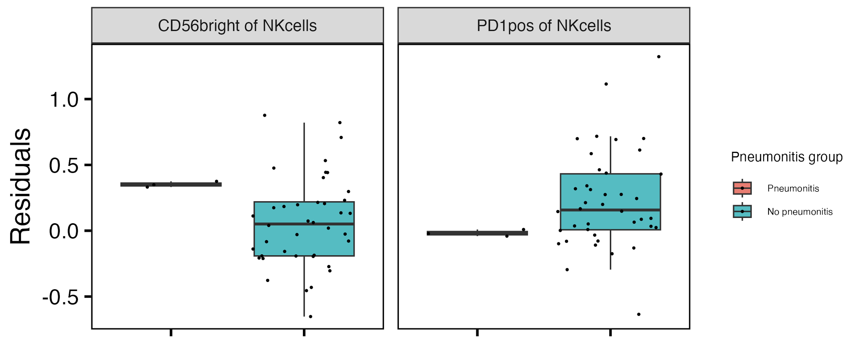
Baseline CD56^{bright} of NK cells frequency higher, PD1⁺ of NK cells frequency lower in those developing pneumonitis
**
**
**: padj < 0.01
Notes:
if including pleural effusion, then PD1+ of NKs drops (padj > 0.05) but it doesn’t matter for CD56bright of NKs
CD56bright NK are abundant cytokine producers but only weakly cytotoxic before activation, PD1+ NK presumably more inhibited…, so these trends make sense with more active → more irAE and more inhibited → less irAE

Slide 12
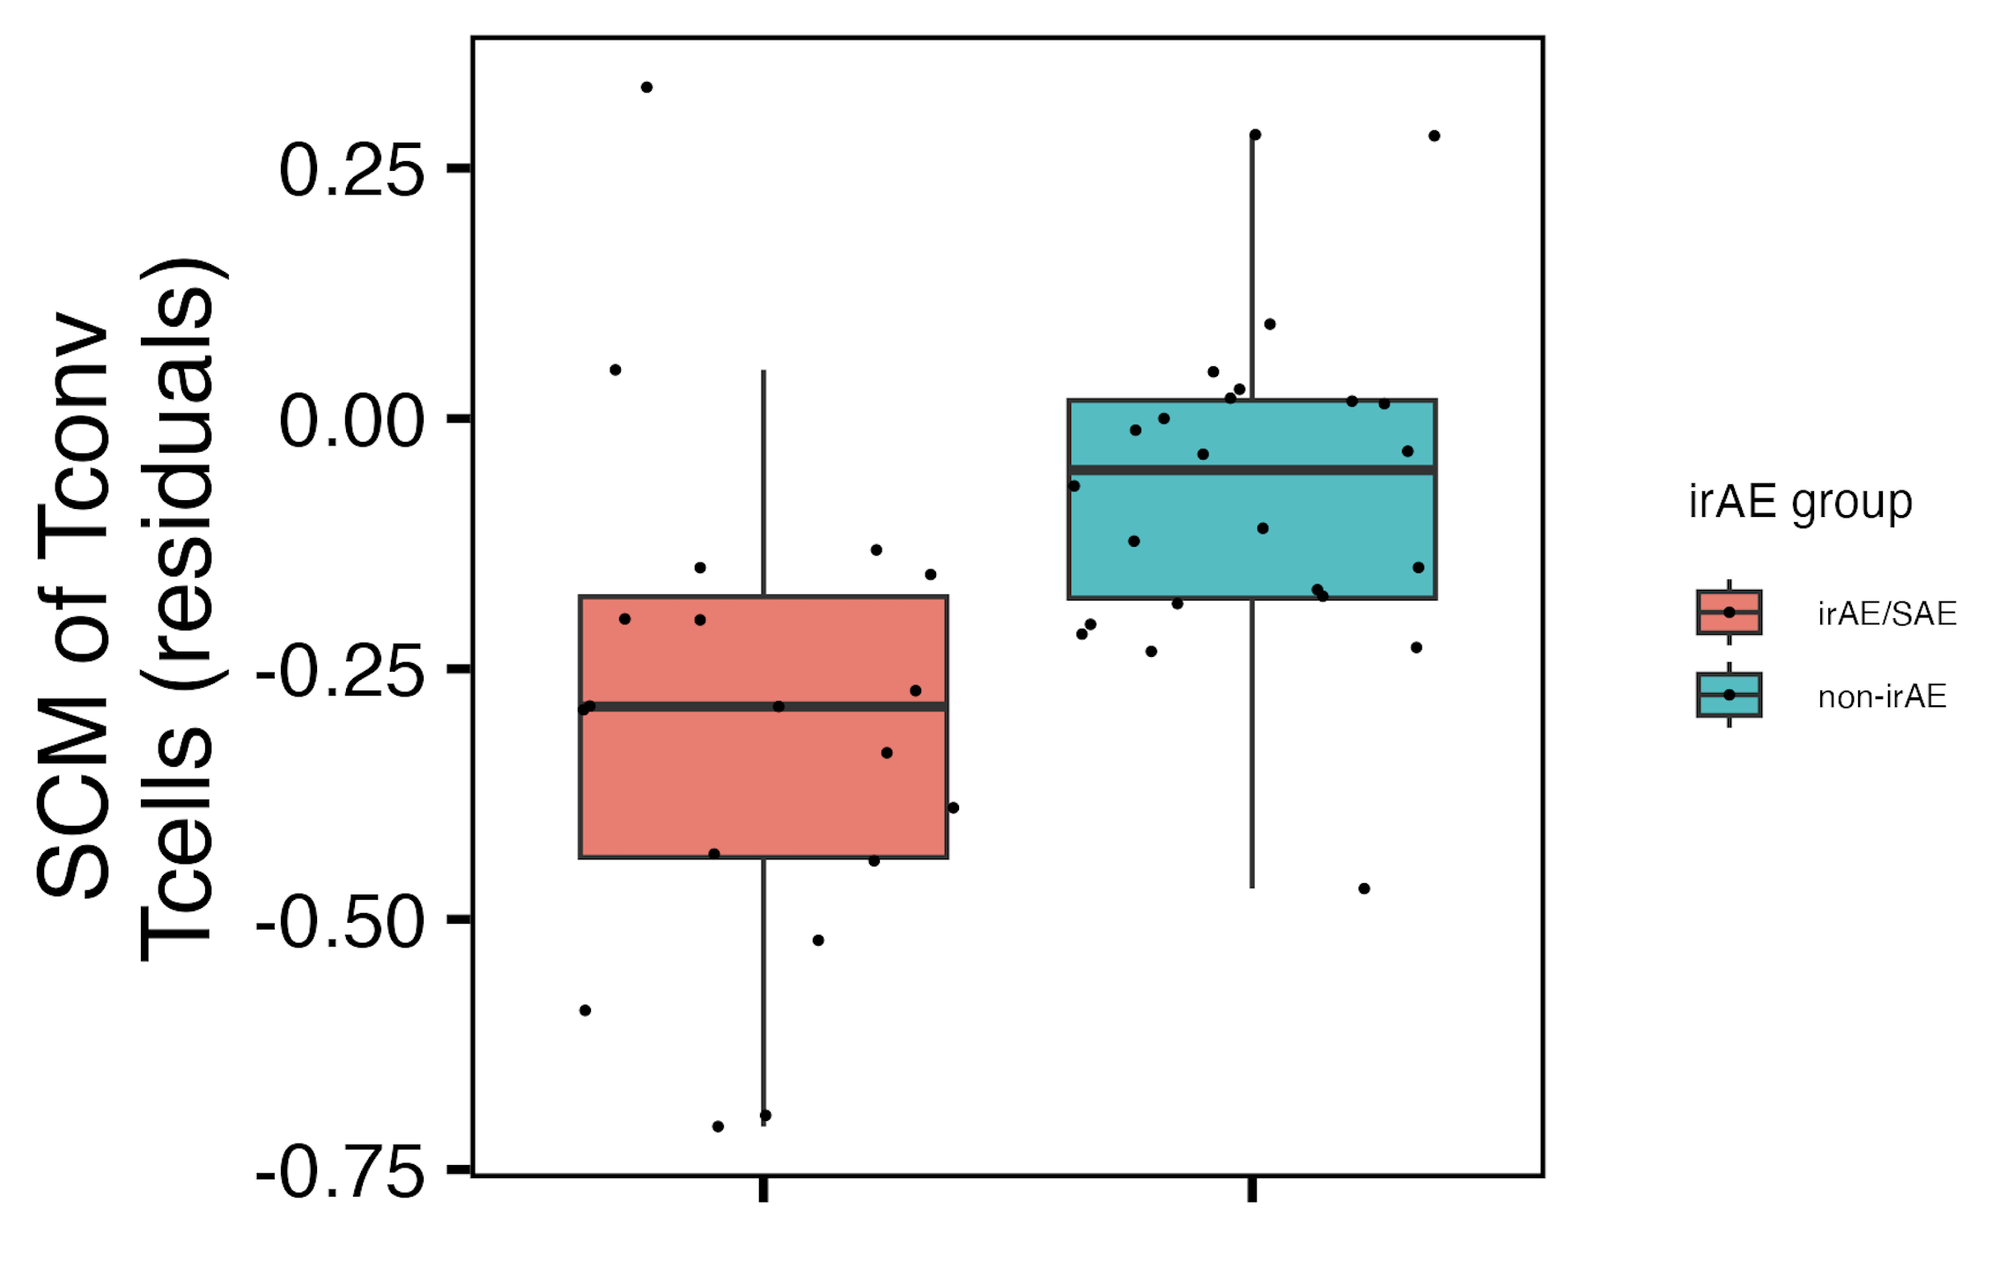
Baseline SCM of T_{conv} T_{cells} frequency may be lower in those developing an irAE
padj = 0.1

Slide 13
Baseline feature module methods
For each irAE group comparison
If irAE group has sufficient n…
use random forest models to order features by importance in irAE group distinction
otherwise for each feature test for difference in baseline frequency distributions between irAE groups and arrange by pval
Take top 4 features as top feature model
PCA only using features in the module
Notes:
For features with < 5% NAs, replace NAs with mean
Should also emphasize that modules are somewhat arbitrary in sense that multiple different configurations of mostly same features would likely work for each module approach taken here

Slide 14
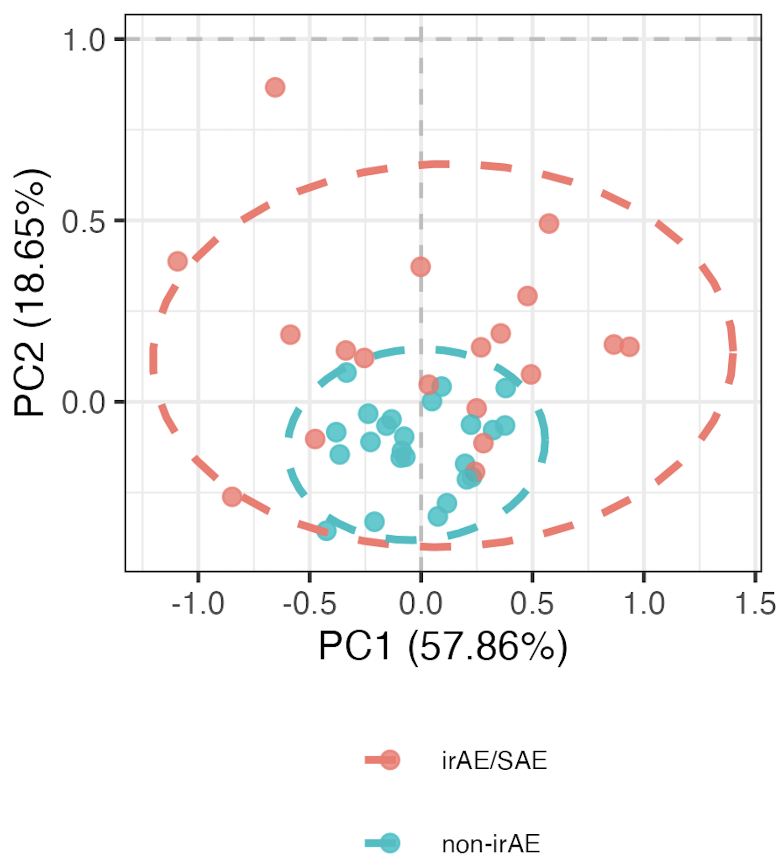
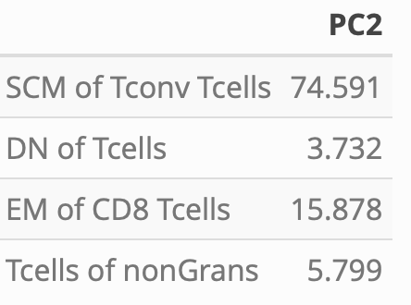
Distinguishing combined irAE group using module of top 4 combined irAE baseline features
PC2 contributions
PC2 **
**: p < 0.01

Slide 15
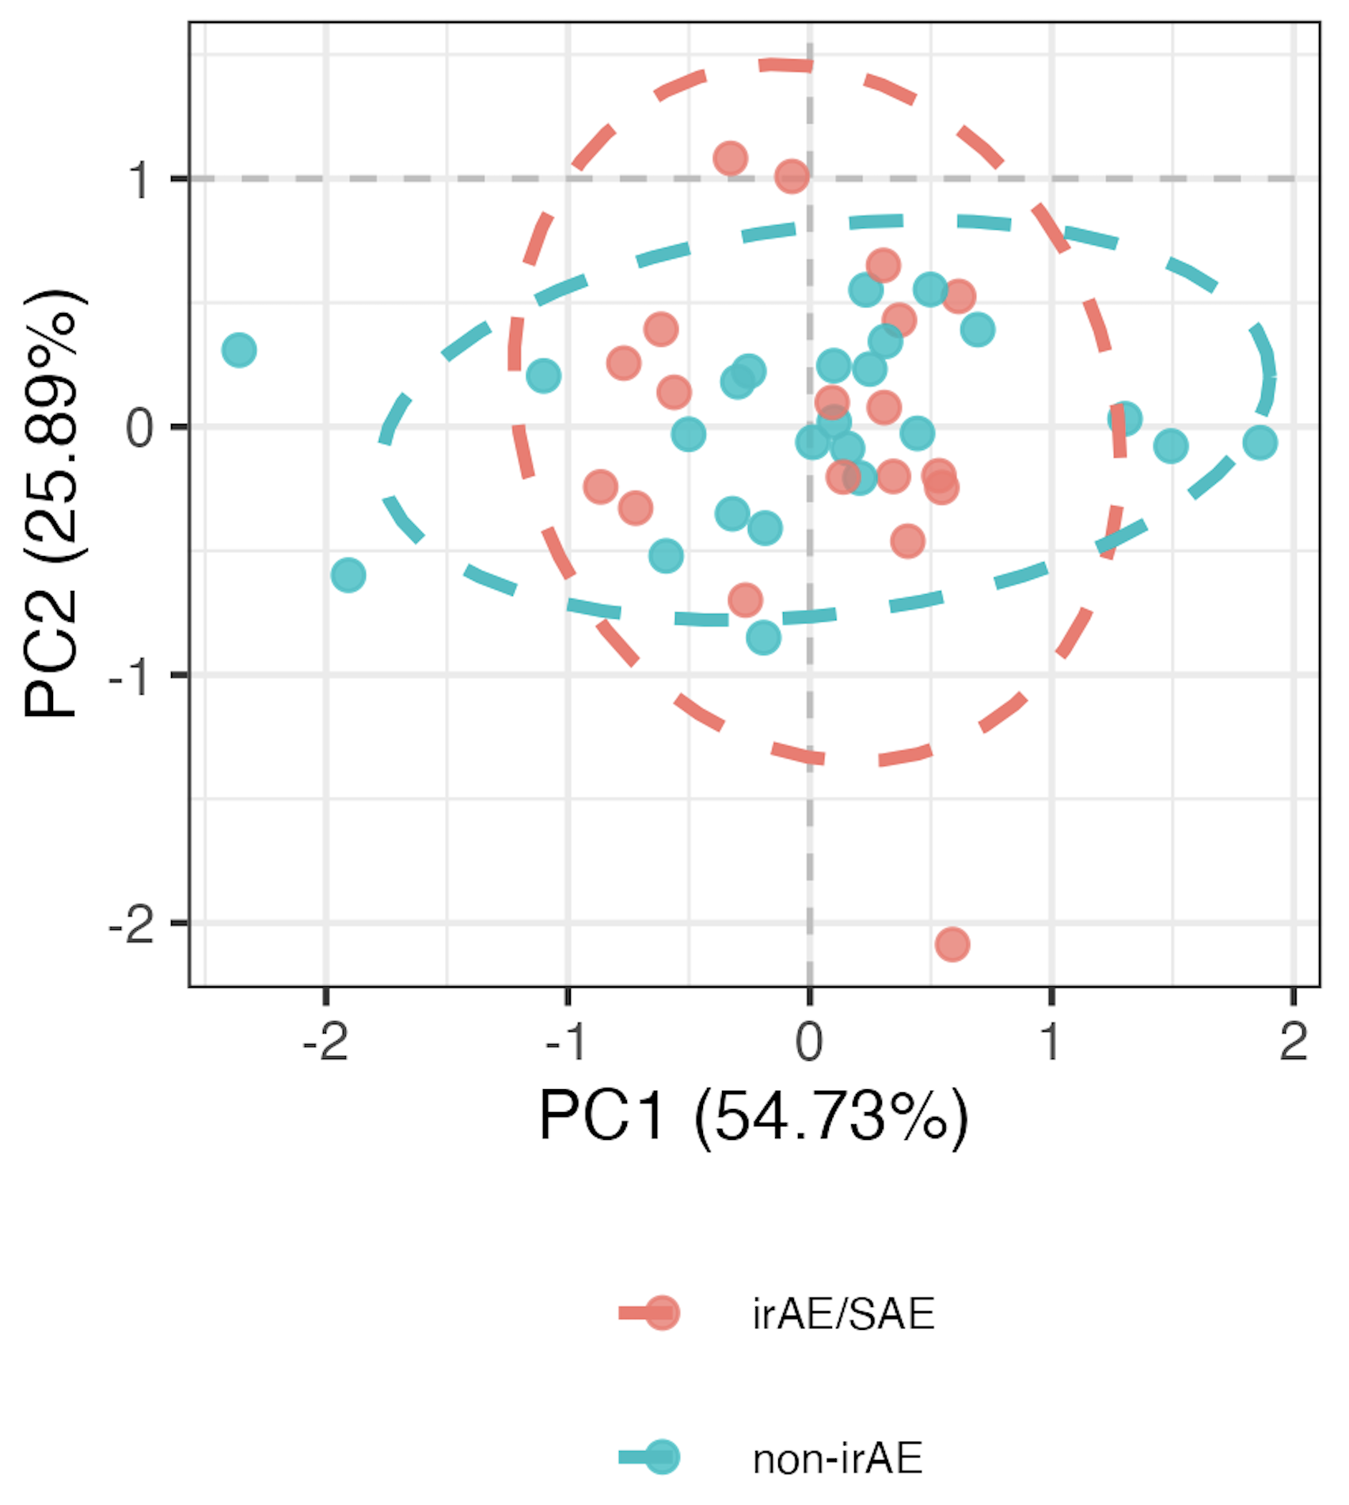
Using randomly formed modules instead
- choosing random set of 4 features 1000 times, obtain similar separation in PCA space ~4.1% of the time
“bottom” 4 feature
module
Notes:
Pvals > 0.9 here for PCs 1-3
> 1 p < 0.01 in PCs 1-3 here for 4% fig
4.1% translates to pval 0.041 (Monte carlo pval)?
SCM feature most common in sets of 4 that hit significance, not surprisingly given it’s a borderline pval itself…

Slide 16
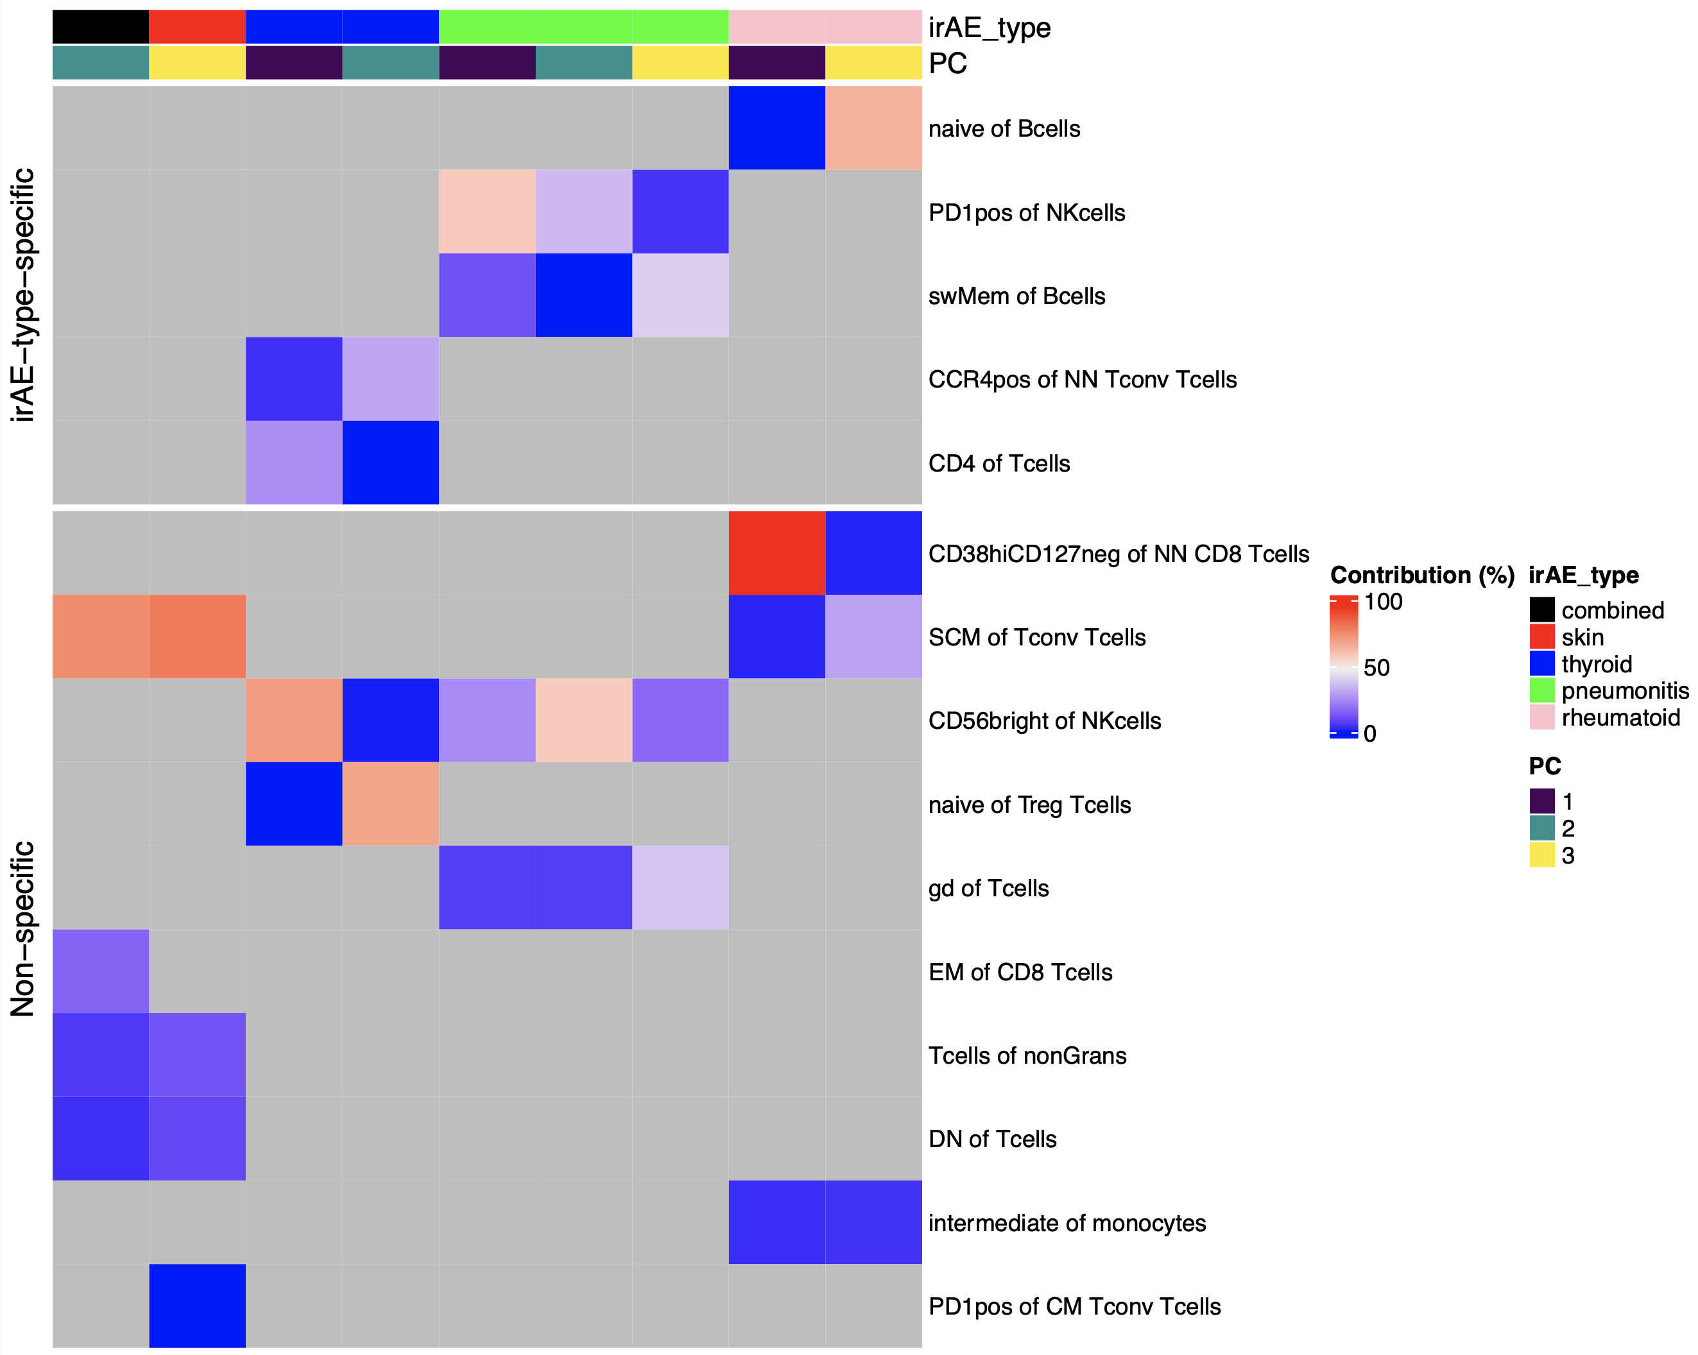
Summary of baseline module analysis: several features may be more irAE-type-specific
Try to relate any of these to literature (baseline)
Notes:
Worth raising concern of overfitting to our data (i.e. subsetting features ~arbitrarily), but the non-specific features with literature evidence are perhaps more backed up here (less biased by noise)
Only showing PCs with p < 0.05 for group comparison

Slide 17
Main questions
Do baseline immune features predict irAE development?
Is irAE development associated with specific changes in immune features on ICI?

Slide 18
Longitudinal analysis methods
Removed PD1⁺ features
Used mixed effect non-linear model with random effect for donor with/without interaction between irAE group & time since baseline → ANOVA on 2 models
Look for features with associations between frequency and time different between irAE groups
model_interaction <- gam(freq ~ irae_group +
s(days_from_baseline, k = 5, bs = "cr", by = irae_group) +
s(patient_id, bs = "re"), data = data, method = 'REML')
Notes:
REML (Restricted Maximum Likelihood) is a statistical technique used for parameter estimation, particularly in mixed-effects models and generalized additive models (GAMs)

Slide 19
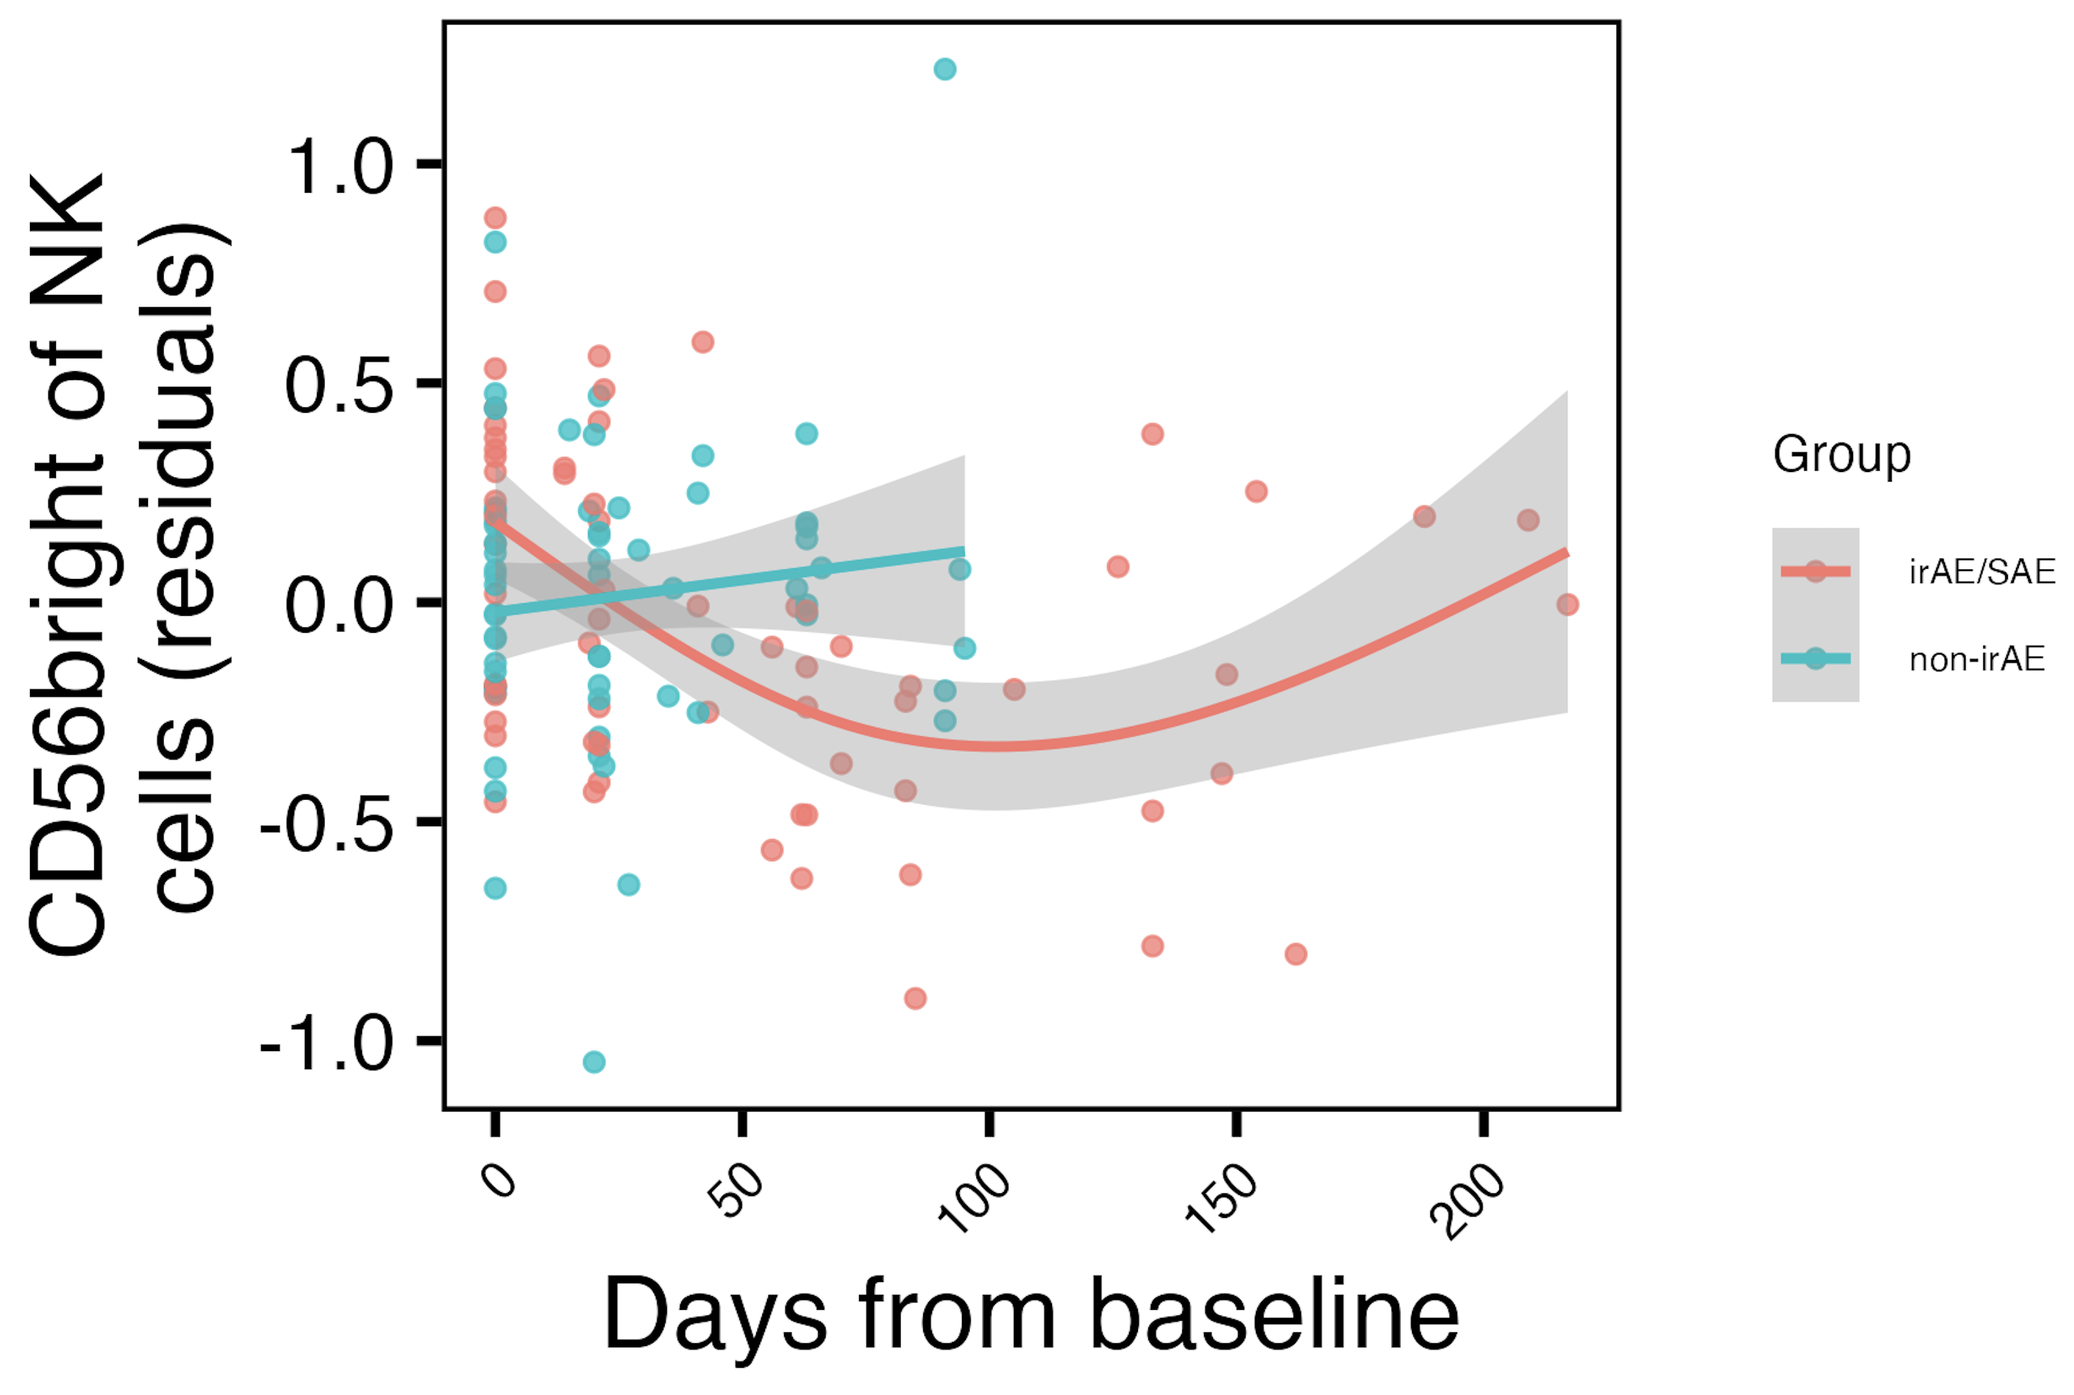
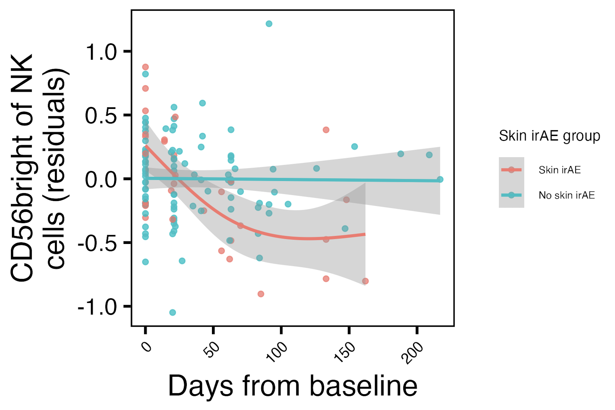
Frequency of CD56^{bright} of NK cells initially decreases with ICI specifically in combined irAE and skin irAE groups
**
*
Any other results that match up with treatment related irAE group effects?
CD56^{bright} of NK frequency reported lower in severe irAE patients at irAE time (Kovacsovics-Bankowski et al. J Immunother Cancer. 2024)
**: padj < 0.01, *: padj < 0.05
Notes:
matches finding from Kovacsovics-Bankowski et al. J Immunother Cancer. 2024 (lower CD56bright of NK in patients at irAE max), surprisingly despite their cohort was mostly not pulmonary irAE and was mostly melanoma!

Slide 20
Conclusions
Baseline analyses
CD56^{bright} of NK cells frequency higher, PD1⁺ of NK cells frequency lower in those developing pneumonitis
SCM of Tconv Tcells frequency may be lower in those developing irAEs, important in modules for distinguishing combined/skin irAEs
Longitudinal analyses: CD56^{bright} of NK frequency initially decreases with ICI in skin/combined irAE groups
Some features may be more irAE-type specific

Slide 21
Speculative model
Fill in

Slide 22
Next steps
IMPACD to look at more granular cell subsets
Test results in public datasets
Clarify what IMPACD will offer in case of Qs
i.e. currently % of parent but what will IMPACD do/offer…
Notes:
Alice W. working on single-param gates to send my way
Public data test is likely ~complicated by needing similar cohorts to see same effects
But public data test would be very important given concerns of overfitting… for the module analysis

Slide 23
Inhibitory immune checkpoints help maintain self tolerance
Khan et al. Semin Cancer Biol. 2020
Notes:
Script:
Immune checkpoint molecules are ligand-receptor pairs that exert stimulatory or inhibitory effects on the immune response
Inhibitory checkpoints are crucial for maintaining self-tolerance and modulating the duration and magnitude of the immune response to minimize tissue damage
CTLA-4 and PD-1/PD-L1 are the most widely studied inhibitory checkpoint molecules.
CTLA-4 outcompetes CD28 (costimulatory receptor) for B7-1/2 ligands on APCs to increase threshold for T cell activation (i.e. reduces immune responses to weak antigens, self/tumor)
PD-1 expressed by activated/induced T cells; this checkpoint prevents inappropriate overactivation and limits duration of T cell activation

Slide 24
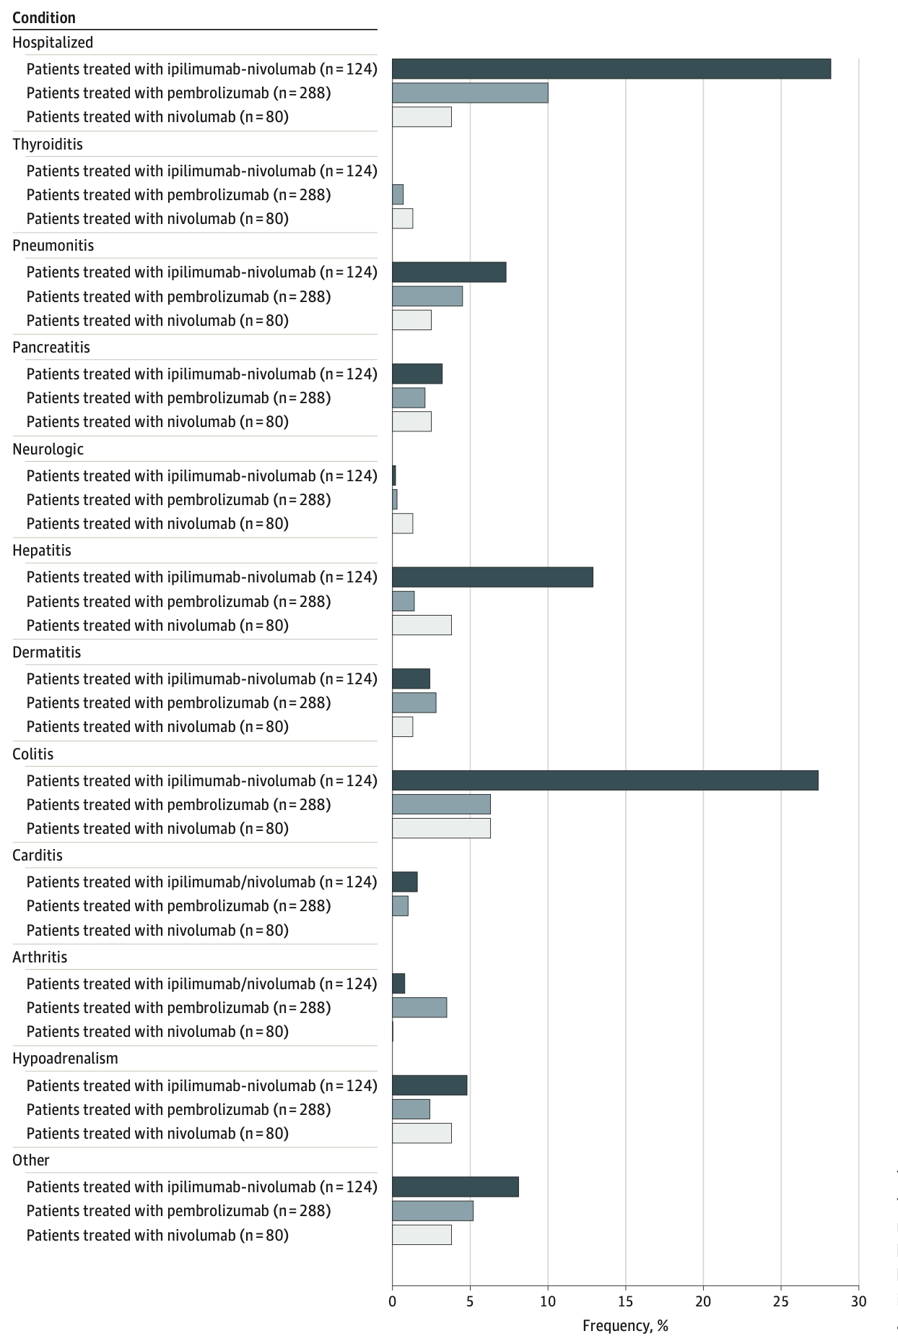
irAEs are rather common and can be severe
Watson et al. JAMA Netw Open. 2022
Notes:
T cell characteristics associated with toxicity to immune checkpoint blockade in patients with melanoma
Autoimmune toxicity occurs in up to 60% of patients treated with immune checkpoint inhibitor (ICI) therapy
Ipilimumab: CTLA-4
Pembrolizumab/nivolumab: PD-1
Perhaps worth trying to make analogy between viral infections preceding autoimmunity and tumor response preceeding irAEs?

Slide 25
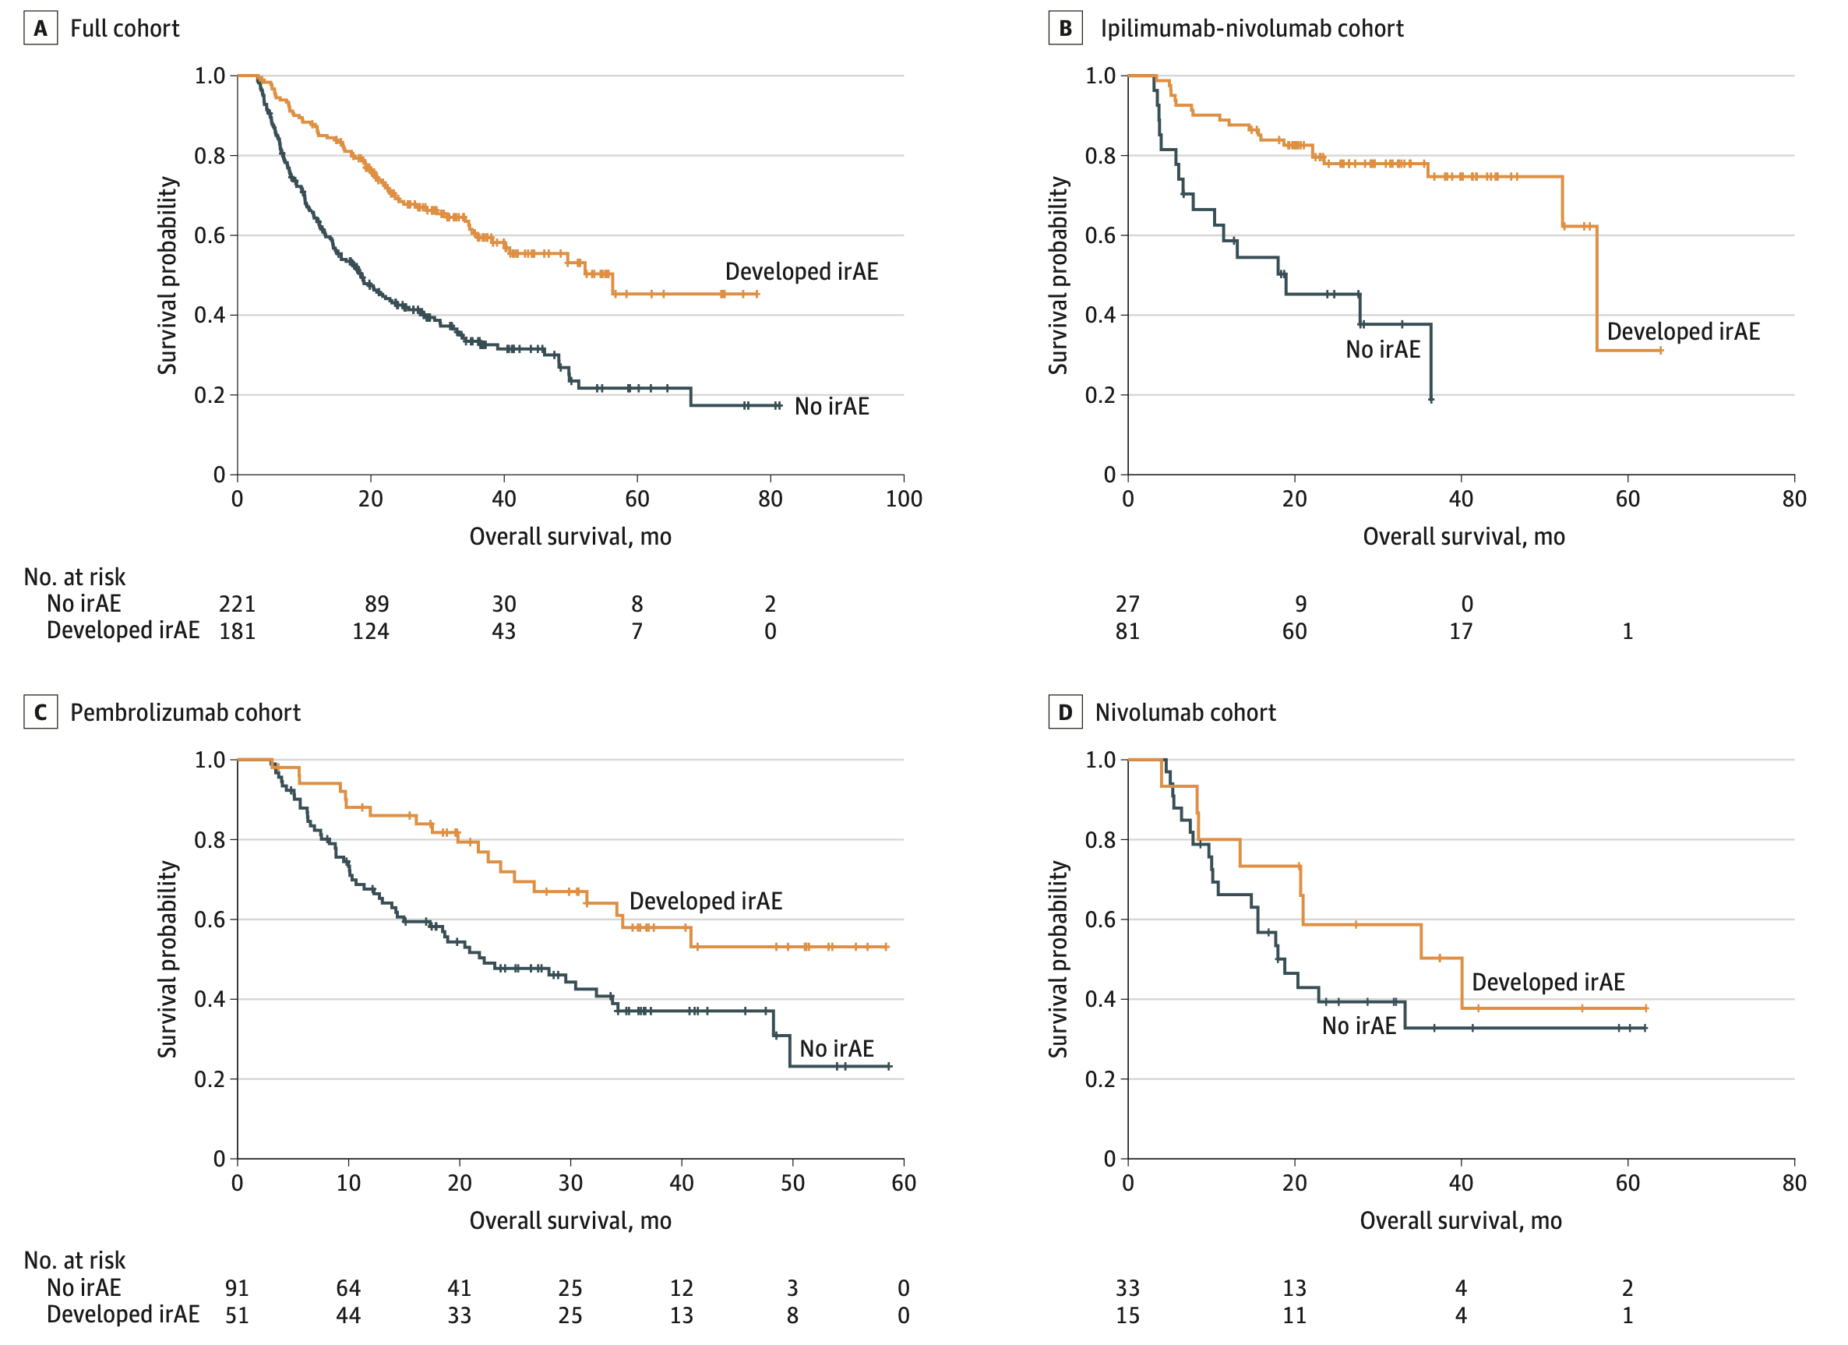
irAE development is associated with anti-tumor response (PMID31021392, PMID26501224, PMID26446948)
Watson et al. JAMA Netw Open. 2022
Notes:
Association of checkpoint inhibitor-induced toxic effects with shared cancer and tissue antigens in non-small cell lung cancer:
irAEs associated with response to therapy (also can cite Association of vitiligo with tumor response in patients with metastatic melanoma treated with pembrolizumab), also Nivolumab in resected and unresectable metastatic melanoma: characteristics of immune-related adverse events and association with outcomes
Characterization of anti-cancer immune response associated with immune-related adverse events in patients with kidney cancer (meeting abstract)
- more irAEs in ICB responders, not a new finding

Slide 26
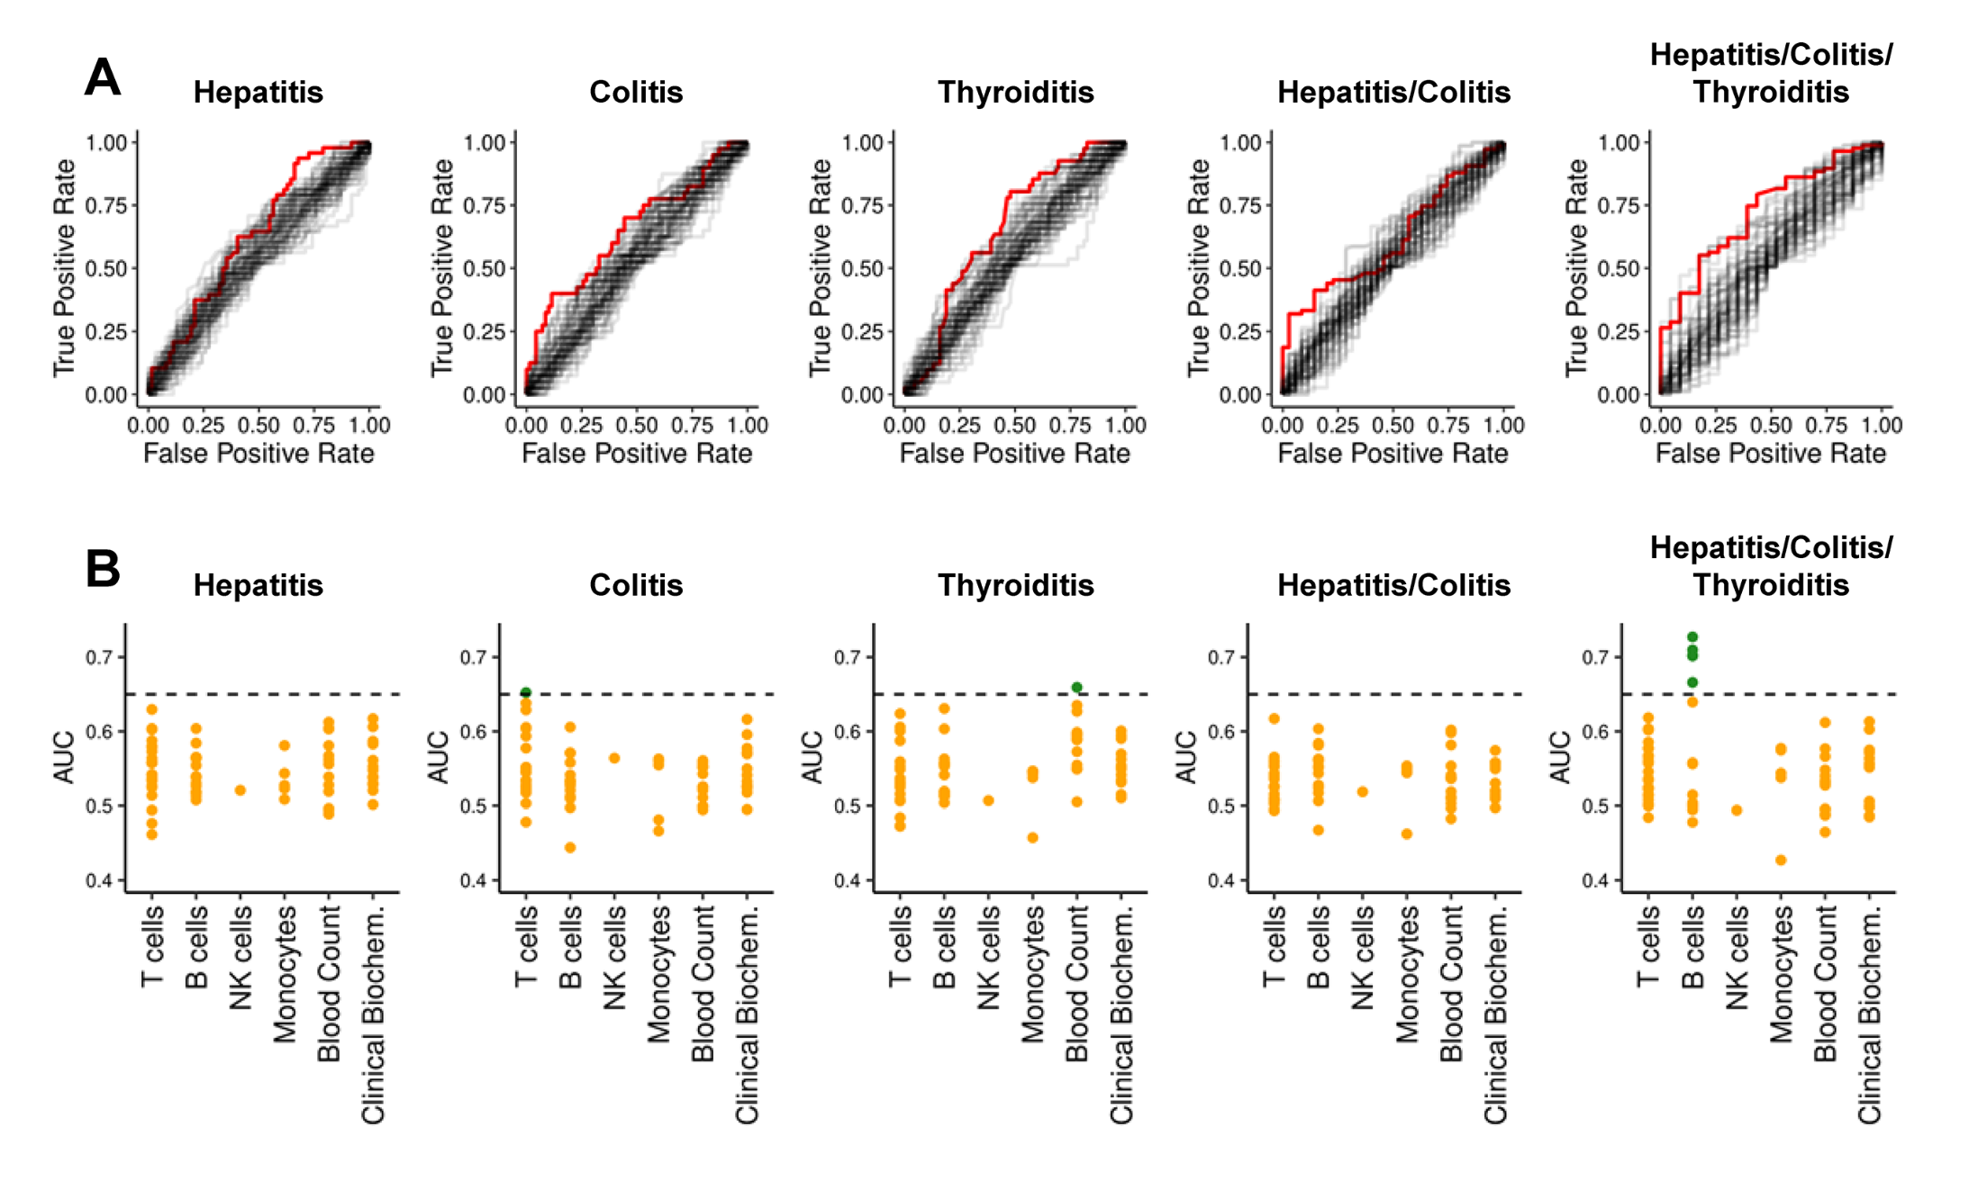
Pre-therapy data generally struggle to reliably predict irAE risk
AUCs for previously reported biomarkers and clinical parameters (68)
**
Glehr et al. Front Immunol. 2022
Notes:
An AUC of 0.5 suggests no discrimination (equivalent to random guessing), while an AUC of 1 indicates perfect discrimination (for predicting irAE)
heterogeneity amongst irAE organs likely complicates prediction
Germline variants associated with toxicity to immune checkpoint blockade: IL7 cryptic exon, IL7 supports aberrant immune activity in autoimmunity, limits organ toxicity during antiviral immune response, blocks PD-1 leading to T1D (blocking checkpoint when it would have prevented autoimmunity, so IL7 acts as a natural ICB and is therefore rationally associated with irAEs
lower baseline levels of CD8 TCM cells in arthritis irAE patients, higher CD4 Th2 baseline levels in pneumonitis irAE patients, higher CD4 Th17 baseline levels in thyroiditis irAE patients (PMID: 36513074)
low baseline circulating MAITs associated with irAE colitis (PMID: 32734627, ~coincides with my analysis)
activated CD4 TEM abundance (in PBMCs) associated with irAE development (PMID: 35027754, ~disagrees with my analysis)
T cell characteristics associated with toxicity to immune checkpoint blockade in patients with melanoma: BASELINE activated CD4 effector memory T abundance and TCR diversity associated with irAE
# Germline genetic variants are associated with development of insulin-dependent diabetes in cancer patients treated with immune checkpoint inhibitors
- *NLRC5* germline mutation as potential predictive biomarker for T1D irAE

Slide 27
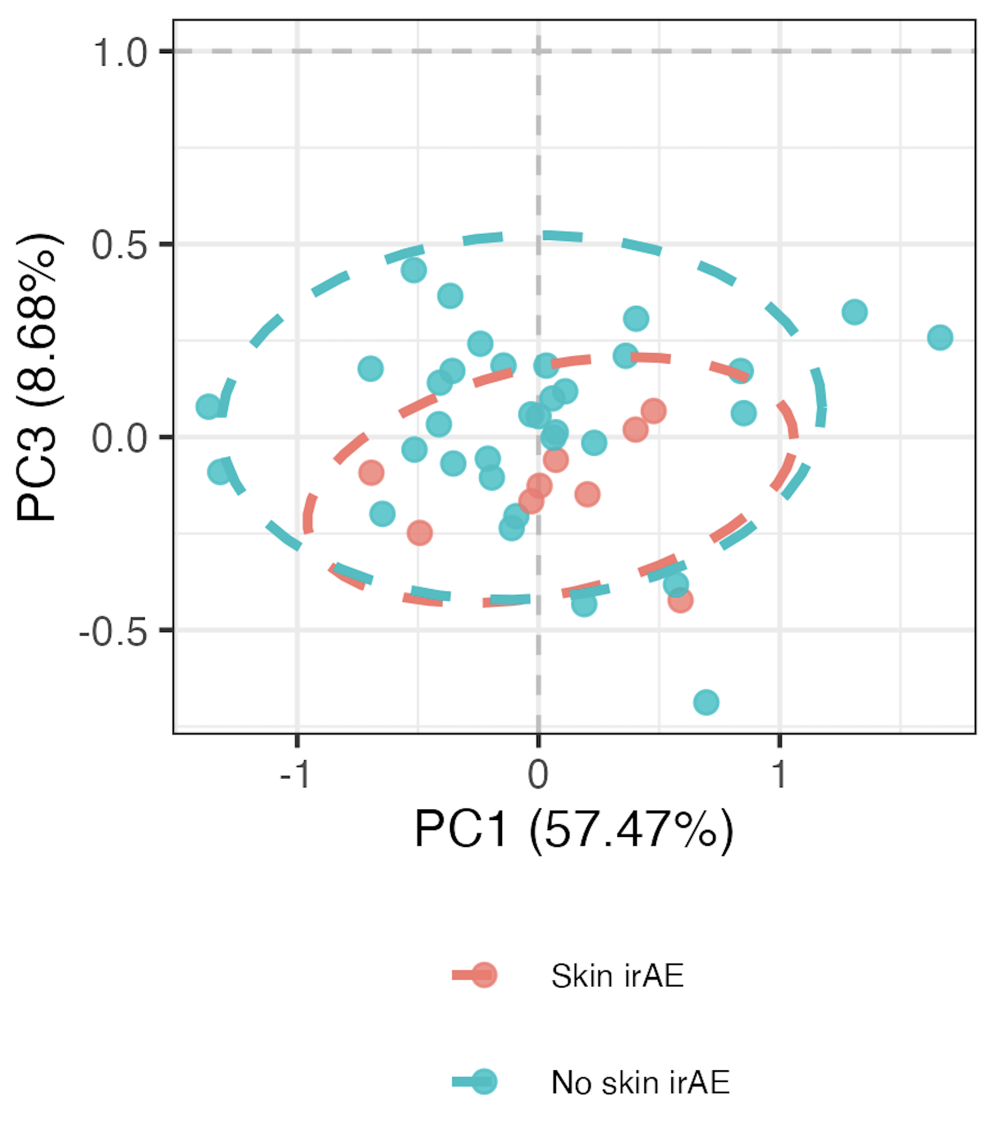
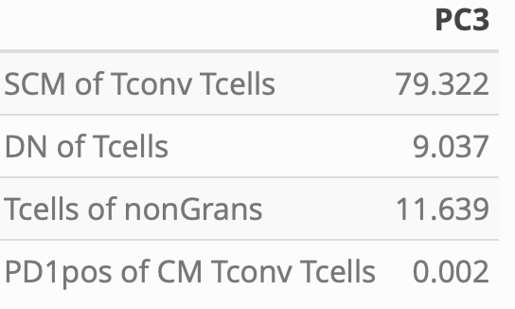
Distinguishing skin irAE group using module of top 4 skin irAE baseline features
PC3 contributions
PC3 *
*: p < 0.05

